Slide 1



KS3 Mathematics
S1 Parallel and Perpendicular Lines
Notes:
The aim of this unit is to teach pupils to:
Use accurately the vocabulary, notation and labelling conventions for lines, angles and shapes; distinguish between conventions, facts, definitions and derived properties
Identify properties of angles and parallel and perpendicular lines, and use these properties to solve problems
Material in this unit is linked to the Key Stage 3 Framework supplement of examples pp 178-183.

Slide 2


Lines in a plane
What can you say about these pairs of lines?
These lines cross, or intersect.
These lines do not intersect.
They are parallel.
Notes:
When we discuss lines in geometry, they are assumed to be infinitely long. That means that any two lines in the same plane (that is in the same flat two-dimensional surface) will either intersect at some point or be parallel. This needs to be remembered in the discussion of the pair of parallel lines here. To be parallel, the lines must not intersect no matter how far they are extended.

Slide 3
Lines in a plane
A flat two-dimensional surface is called a plane.
Any two straight lines in a plane either intersect once …
This is called the point of intersection.

Slide 4
Lines in a plane
… or they are parallel.
We use arrow heads to show that lines are parallel.
Parallel lines will never meet.
They stay an equal distance apart.
We can say that parallel lines are always equidistant.
Where do you see parallel lines in everyday life?
Notes:
Pupils should be able to identify parallel and perpendicular lines in 2-D and 3-D shapes and in the environment.
For example: rail tracks, double yellow lines, door frame or ruled lines on a page.

Slide 5
Perpendicular lines
What is special about the angles at the point of intersection here?
a
a = b = c = d
b
d
Each angle is 90°. We show this with a small square in each corner.
c
Lines that intersect at right angles are called perpendicular lines.
Notes:
Pupils should be able to explain that perpendicular lines intersect at right angles.

Slide 6
The distance from a point to a line
What is the shortest distance from a point to a line?
O
The shortest distance from a point to a line is always the perpendicular distance.
Notes:
Ask pupils to point out which line they think is the shortest and ask them what they notice about it.
Ask pupils if they think that the shortest line from a point to another line will always be at right angles.
Reveal the rule.

Slide 7
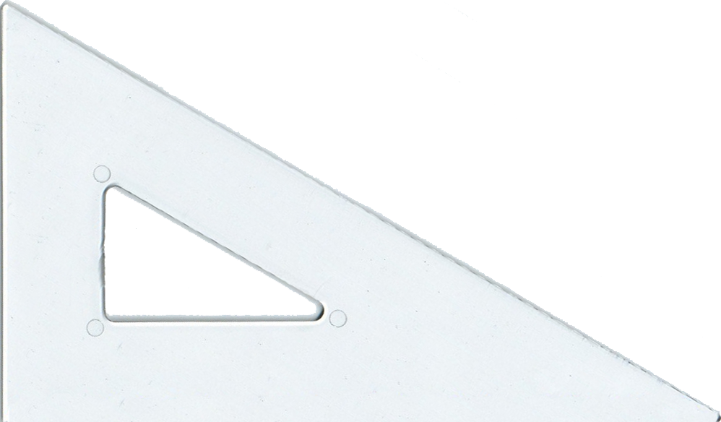
Drawing perpendicular lines with a set square
We can draw perpendicular lines using a ruler and a set square.
Draw a straight line using a ruler.
Place the set square on the ruler and use the right angle to draw a line perpendicular to this line.

Slide 8
Drawing parallel lines with a set square
We can also draw parallel lines using a ruler and a set square.
Place the set square on the ruler and use it to draw a straight line perpendicular to the ruler’s edge.
Slide the set square along the ruler to draw a line parallel to the first.

